Slide 1
Chapter 5: Functional Modeling
CIS 315
Stefan Bund, MS
Cal Poly Pomona

Slide 2
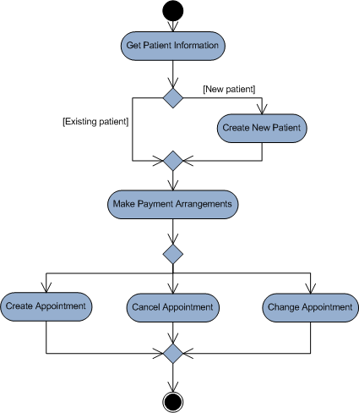
Sample Activity Diagram
Business process models like activity diagrams describe the activities or behaviors that collectively support a business process.
A very powerful tool for communicating the analyst’s current understanding of the requirements with the user.

Slide 3
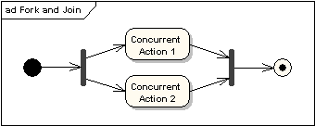
Activity Diagram Elements (Contd.)
Fork and Join Nodes Forks and joins have the same notation: either a horizontal or vertical bar (the orientation is dependent on whether the control flow is running left to right or top to bottom). They indicate the start and end of concurrent threads of control. The following diagram shows an example of their use.

Slide 4
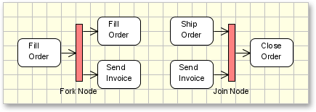
Activity Diagram Elements (Contd.)
Fork node and Join node (Contd.)
A fork node is a control node that splits a flow into multiple concurrent flows.
A join node is a control node that synchronizes multiple concurrent flows.

Slide 5
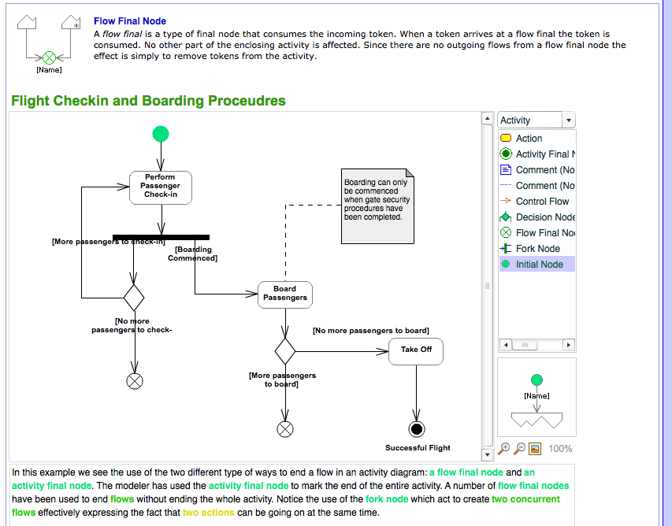
Flow final code vs. Activity final node
The flow final node denotes the end of a single control flow;
The activity final node denotes the end of all control flows within the activity.
Source: http://www.zicomi.com/flowFinalNode.jsp

Slide 6
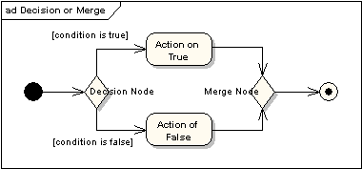
Activity Diagram Elements (Contd.)
Decision and Merge Nodes Decision nodes and merge nodes have the same notation: a diamond shape. They can both be named. The control flows coming away from a decision node will have guard conditions which will allow control to flow if the guard condition is met. The following diagram shows use of a decision node and a merge node.

Slide 7
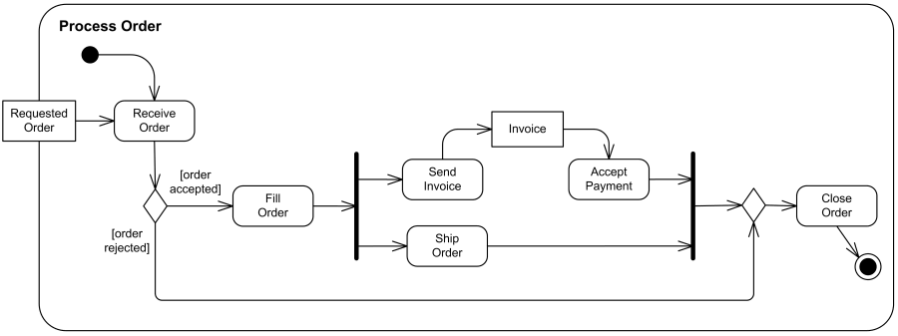
Activity Diagram Example: Process Order

Slide 8


Use Case Diagram Syntax
Actor
person or system that derives benefit from and is external to the subject
Use Case
Represents a major piece of system functionality
Association Relationship
Include Relationship
Extend Relationship
Generalization Relationship
<<includes>>
<<extends>>
System boundary
Note

Slide 9
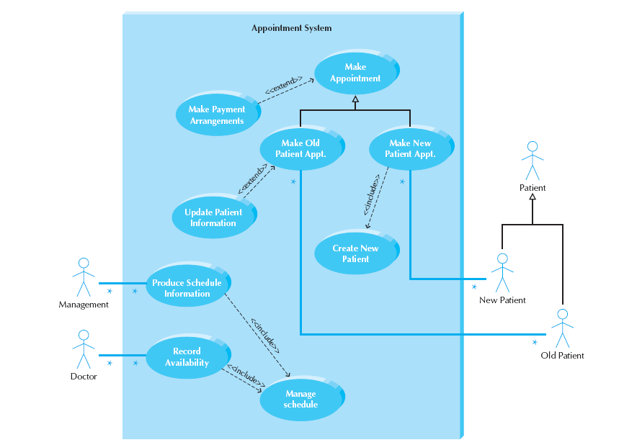
Sample Use Case Diagram Patient Appointment System

Slide 10
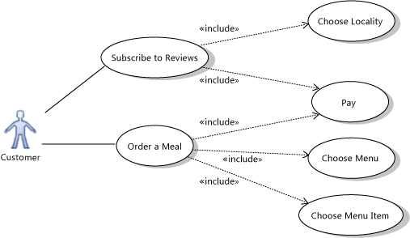
Showing the details of a use case with Include
Use an Include relation to show that one use case describes some of the detail of another. In the illustration, Order a Meal includes Pay, Choose Menu, and Choose Menu Item. Each of the included, more detailed use cases is a step that the actor or actors might have to perform to achieve the overall goal of the including use case. The arrow should point at the more detailed, included use case.
Caution
You should not make loops of include relationships that result in a use case including itself. Loops can generate errors.
You can share included use cases. In the example, the Order a Meal and Subscribe to Reviews use cases both include Pay.

Slide 11
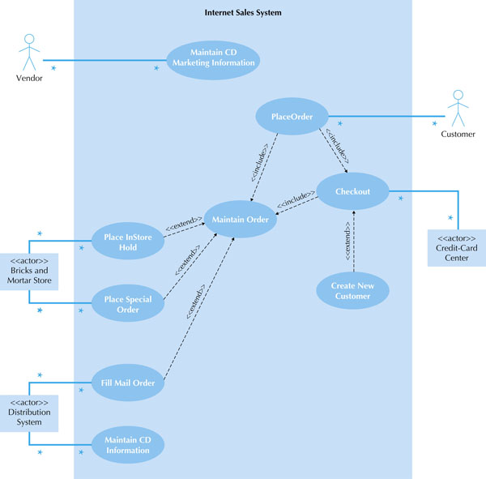
Sample Use Case Diagram CD Selections

Slide 12
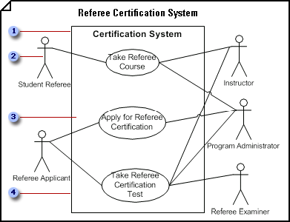
Use Case Diagram Example
Defining the system boundary determines what is considered external or internal to the system.
An actor represents a role played by an outside object. One object may play several roles and, therefore, is represented by several actors.
A communicates relationship illustrates the participation of the actor in the use case.
A use case is a set of events that occurs when an actor uses a system to complete a process. Normally, a use case is a relatively large process, not an individual step or transaction.
Source: http://office.microsoft.com/en-us/help/use-case-diagram-example-HP081550288.aspx?CTT=5&origin=HP081550281

Slide 13
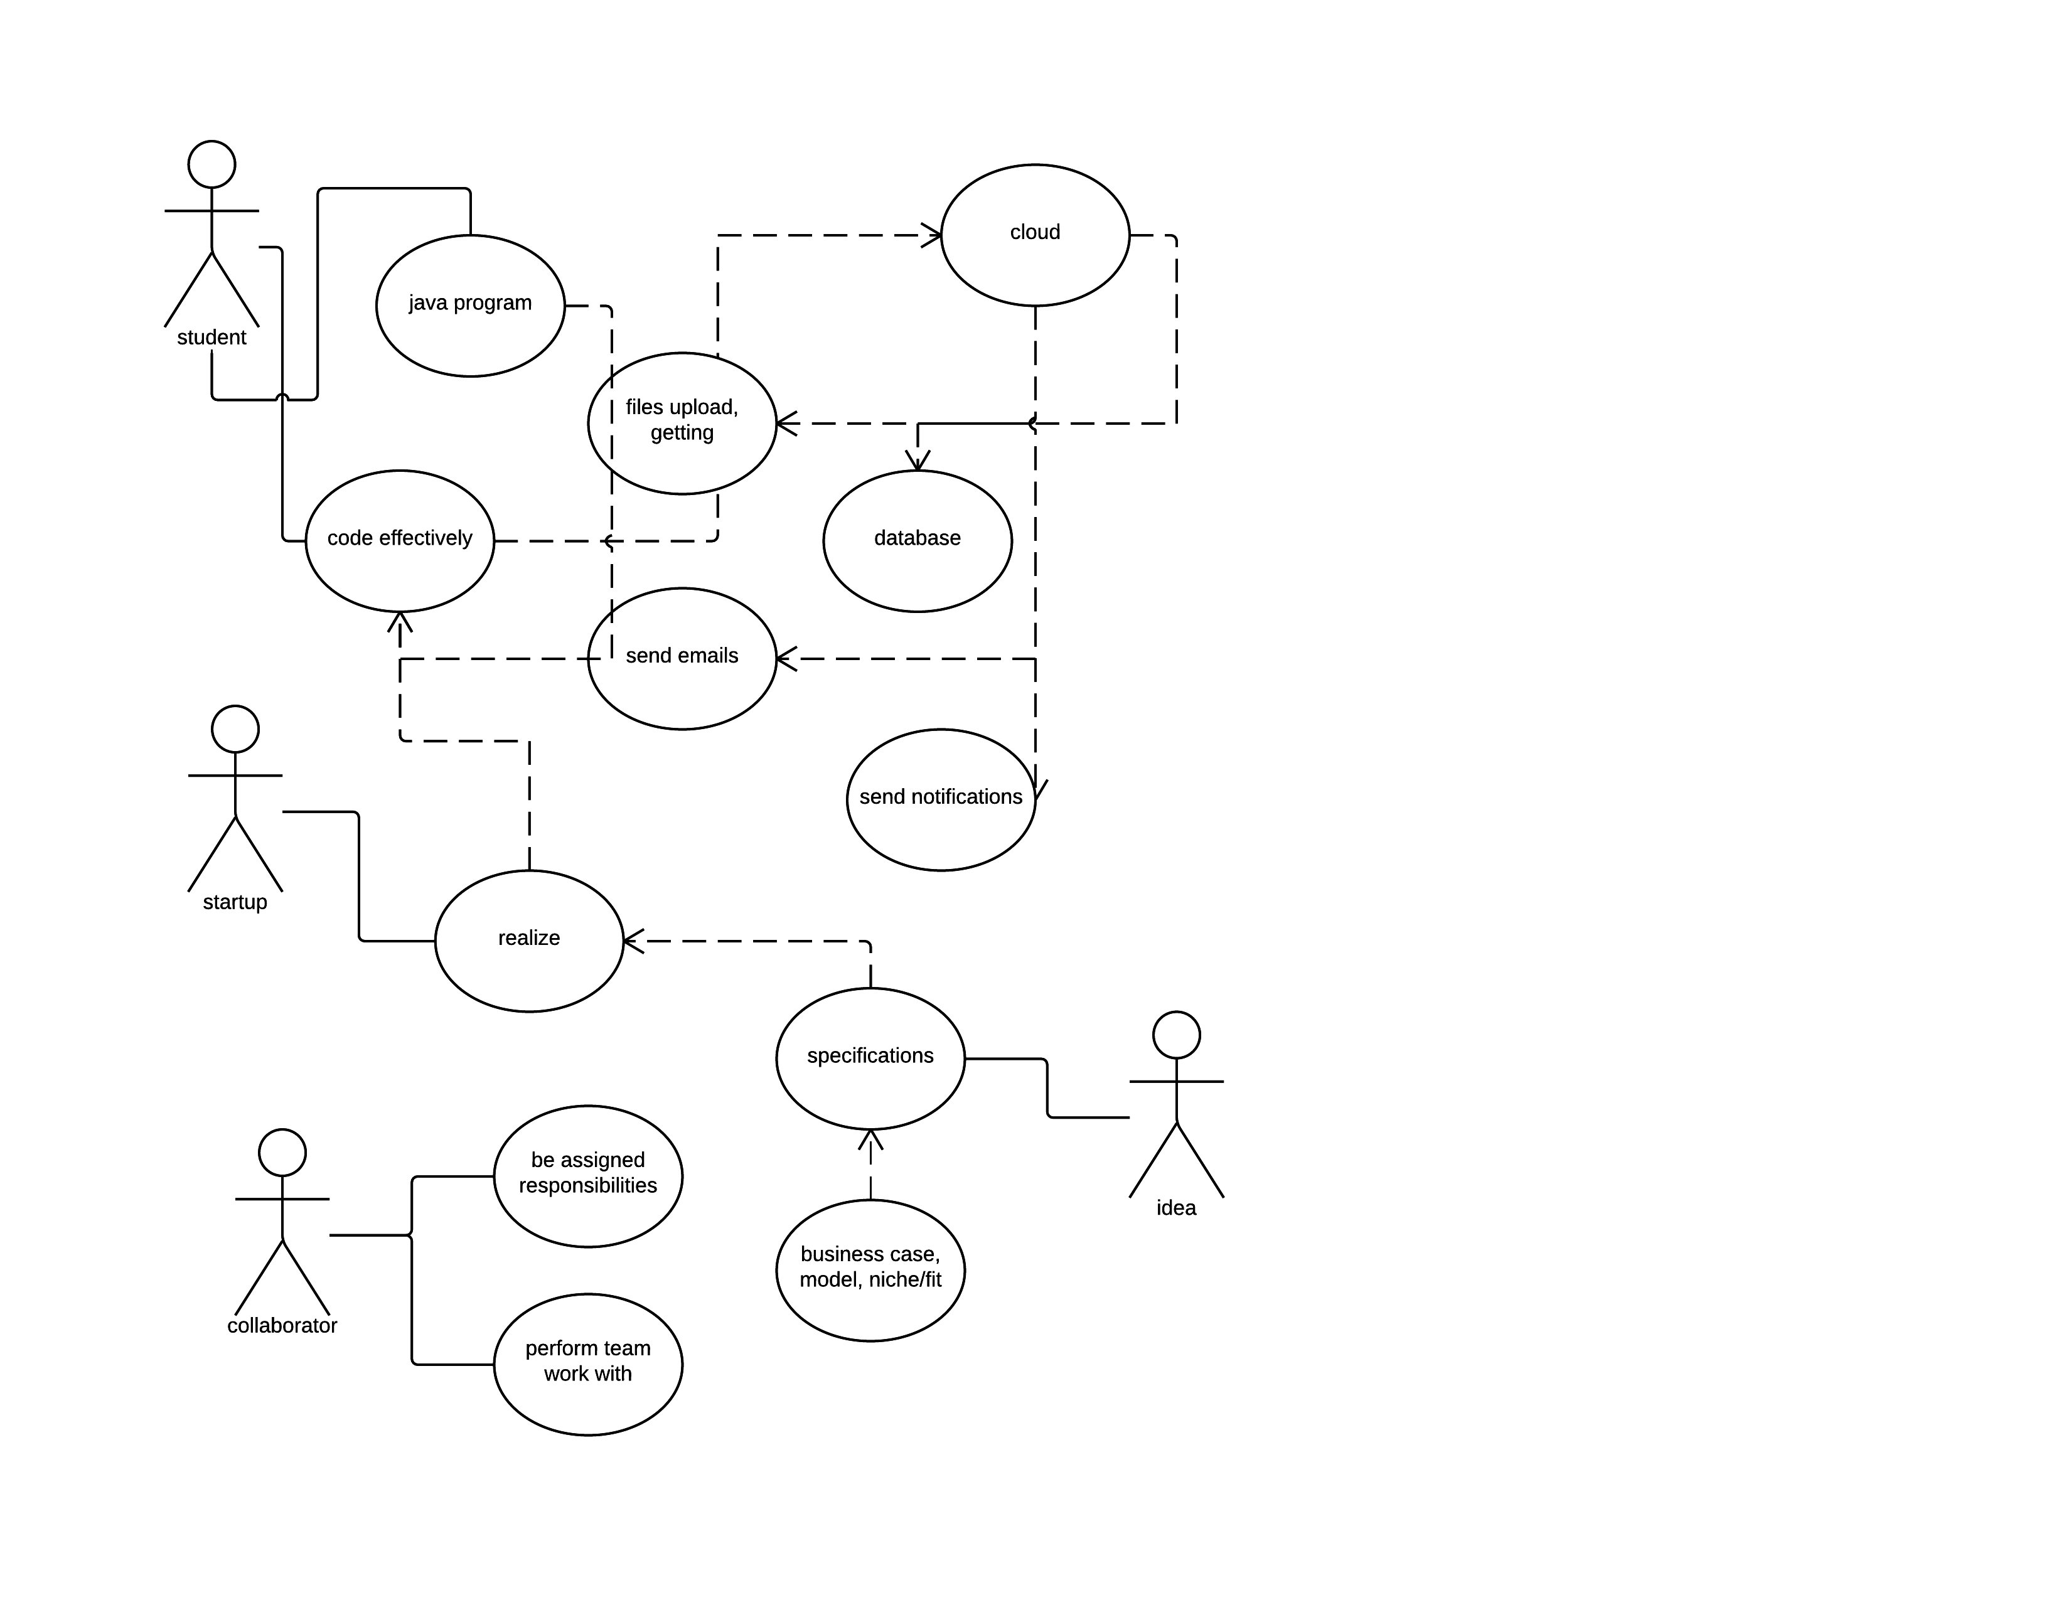

Slide 14
Premise of startup kit
IT startups need a leg up in terms of getting started
We can apply our cloud expertise in constructing a general-use toolkit to stage It projects on top of

Slide 15
What should startup kit do?
Provide “crazy” people with means to generate working software
It should be very easy to create:
Databases
Domains / tables / attributes
Read / write to those databases
Send emails
Send out notifications for devices
Upload and download images

Slide 16
Startup kit…
Jump starts all potential IT projects through fulfilling these basic means for producing software

Slide 17
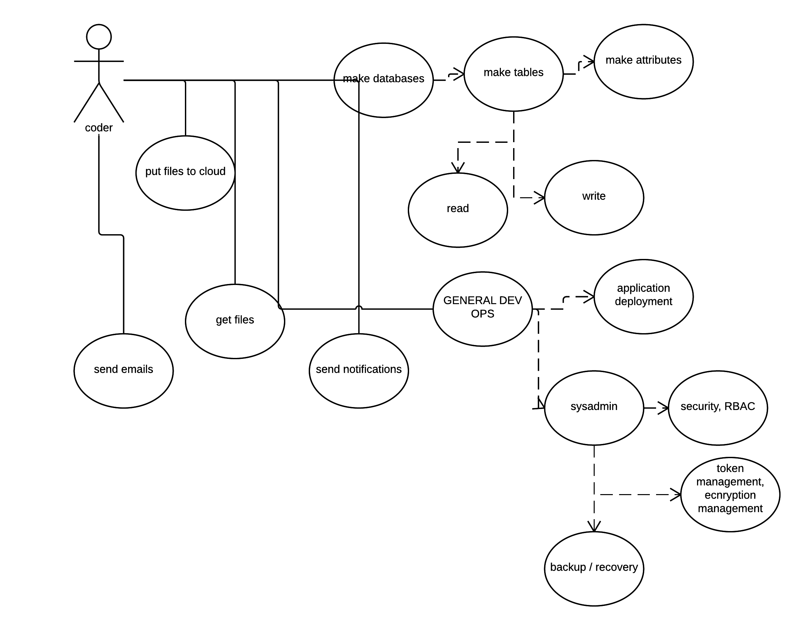

Slide 18
